Slide 1


Chukwuebuka Ifechukwu
20/08/2022

Slide 2

Outline
Executive Summary
Introduction
Methodology
Results
Conclusion
Appendix

Slide 3
Executive Summary
By obtaining the SpaceX data through its API and Webscraping Wikipedia and then wrangling it, we are able to perform various exploratory analysis on them such as Visualization, SQL, Folium maps, interactive dashboard with Ploty. This analysis would allow us determine what factors were important in regards to having a successful landing outcome for the first stage. This will then lead to building a model with Machine learning that is able to accurately predict if a launch will have a successful outcome.

Slide 4
Introduction
Project background and context
Problems you want to find answers

Slide 5

Section 1

Slide 6
Methodology
Executive Summary
Data collection methodology:
Describe how data was collected
Perform data wrangling
Describe how data was processed
Perform exploratory data analysis (EDA) using visualization and SQL
Perform interactive visual analytics using Folium and Plotly Dash
Perform predictive analysis using classification models
How to build, tune, evaluate classification models

Slide 7
Data Collection
The data collection was done through two(2) processes which included:
API Collection:- This process involved making a call to SpaceX api to obtain the necessary information. The calls were made based on the information provided about the api.
Webscraping:- This process involved scraping a Wikipedia site which has the information using python’s BeautifulSoup package

Slide 8
Data Collection – SpaceX API
With the use of the SpaceX api, data required was collected using Python’s request library. This information was then stored into a DataFrame for further analysis
GitHub URL of the completed SpaceX API calls notebook - https://github.com/Ebuka21/IBM_Data_Science/blob/main/spacex-data-collection-api.ipynb
Python
Request package
SpaceX API
Store information into Dataframe
Perform Data Cleaning
Save cleaned data by converting dataframe to csv

Slide 9
Data Collection - Scraping
Information about Falcon 9 was obtained from Wikipedia page by scraping it through the use of BeautifulSoup package in Python
GitHub URL of the completed Webscraping notebook - https://github.com/Ebuka21/IBM_Data_Science/blob/main/spacex-webscraping.ipynb
Python
Request package
SpaceX API
Store information into Dataframe
Perform Data Cleaning
Save cleaned data by converting dataframe to csv

Slide 10
Data Wrangling
With the isnull function, we were able to check for null values within the dataset. Also, checked the type data in each column to ensure that it is correct.
With value_counts, we were able to see the number of launched for each category under LaunchSite and Orbit
Created a new column called “Class” which had the value of 0(bad) or 1(good) based on the outcome column
GitHub URL - https://github.com/Ebuka21/IBM_Data_Science/blob/main/spacex-Data%20wrangling.ipynb

Slide 11
EDA with Data Visualization
GitHub URL of completed EDA with data visualization notebook:- https://github.com/Ebuka21/IBM_Data_Science/blob/main/EDA%20with%20Visualization.ipynb
Through visualization, we will explore the relationships between the data attributes and observe if there is a correlation to determine a successful landing.
Payload vs Flightnumber: From the diagram below we can see that the higher payloads seem to be have a higher success rate
Success rate of each orbit: The mean success rate of each orbit was examined so note which orbit should be aimed for higher success rate
- Yearly success trend: The success rate per year was plotted which shows an increase from year to year

Slide 12
EDA with SQL
GitHub URL of completed EDA with SQL notebook: https://github.com/Ebuka21/IBM_Data_Science/blob/main/EDA%20with%20SQL.ipynb
By uploading the data collected into our database (DB2), we are able to perform some analysis by answering some questions. The database is connected from notebook to achieve this
These questions include:
Unique launch sites
Average Payload for Falcon 9
Total payload
Distinct names for landing outcomes
Total number of successful and failure mission outcomes

Slide 13
Build an Interactive Map with Folium
Folium markers and circles were used to identify the launch sites.
Using the class column of the dataset, markers representing success and failure were set. 1 represents success and is marked as “green” while 0 represents failure and is marked as “red”.
We will the be able to see the number of launches from each site and on zooming into each site, visually see the number of success and failed launches.
Then looked at what was in proximity of the launch sites
GitHub URL of notebook with interactive map with Folium map: https://github.com/Ebuka21/IBM_Data_Science/blob/main/lab_jupyter_launch_site_location.ipynb (view using link https://nbviewer.org/ to view maps)

Slide 14
Build a Dashboard with Plotly Dash
With the use of Plotly, we are able to design a dashboard that is interactive
Pie charts were drawn to show the percentage of success and failed launches for each launch site as well as in total.
Scatter plot was done to show the relationship between the payload mass and class column of the dataset which represent success or failure. The booster version was used to distinguish the plot points
GitHub URL of Plotly Dash lab: https://github.com/Ebuka21/IBM_Data_Science/blob/main/spacex_dash_app.py

Slide 15
Predictive Analysis (Classification)
The aim is to be able to predict if the first stage of the rocket launch can land successfully for it to be reused.
With the numpy and pandas library, loaded the data into a dataframe
Proceeded to standardize the data within the dataframe before splitting them in train and test data with the use of packages from the sklearn library in Python
The following models were made to train the data as well as test
Logistic Regression
SVC
Decision Trees
K Nearest Neighbors
This was done with the help of GridSearchCV to determine the best parameters for each of the models
GitHub URL for predictive analysis notebook: https://github.com/Ebuka21/IBM_Data_Science/blob/main/SpaceX_Machine%20Learning%20Prediction_Part_5.ipynb

Slide 16
Results
Exploratory data analysis results
Launch Sites Proximity Analysis
Plotly Dashboard
Predictive analysis results

Slide 17

Section 2

Slide 18
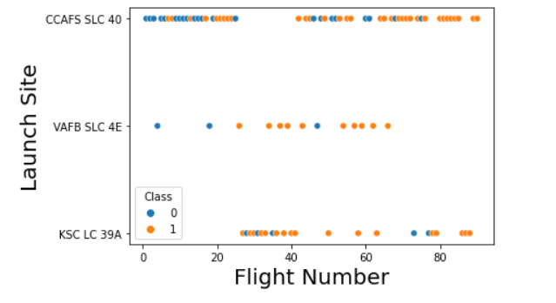
Flight Number vs. Launch Site
This visualization shows how the Flight Number of the launches relate to the site they were launched from.
We can see that for all sites, more of the success (1) occurs at the higher flight numbers or as the flight numbers increase.
This could suggest an increase in technology and accuracy with more launches been done as well as experience

Slide 19
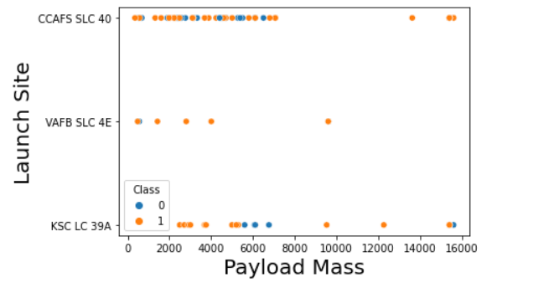
Payload vs. Launch Site
This visualization shows how the Payload Mass relates to launch sites with success or no success categorised in colors.
We can see that for CCAFS SLC 40, the higher the payload, the higher the success rate.
For VAFB SLC 4E, it seems with the exception of a few launches, majority of the it was successful regardless of the payload

Slide 20
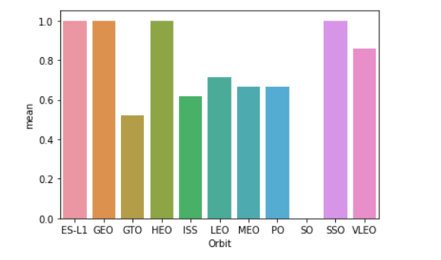
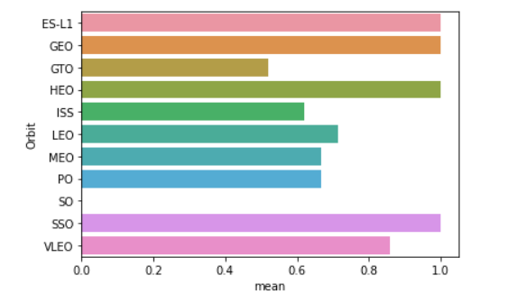
Success Rate vs. Orbit Type
The mean success rate for the orbit where the launches were sent to are plotted as a bar chart
With this we can see that out of all the orbit, ES-L1, GEO, SSO and HEO orbit have a higher success rate

Slide 21
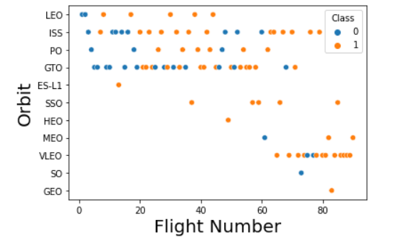
Flight Number vs. Orbit Type
This visualization looks at the relationship between the flight number and orbit
We can see that the orbits ES-L1, GEO, SSO and HEO which have a high mean success rate have a low number of flights launched to them.
We also see that for the LEO orbit, the chances of success increased with the increase in flight number

Slide 22
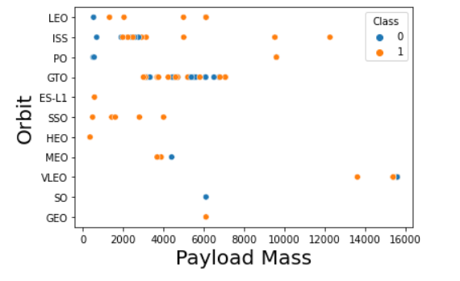
Payload vs. Orbit Type
By plotting the Payload mass against the Orbit, we can see the influence of payload on the chances of success for each orbit
Here we that for the LEO and ISS orbit, an increase in Payload mass led to a higher chances of success

Slide 23
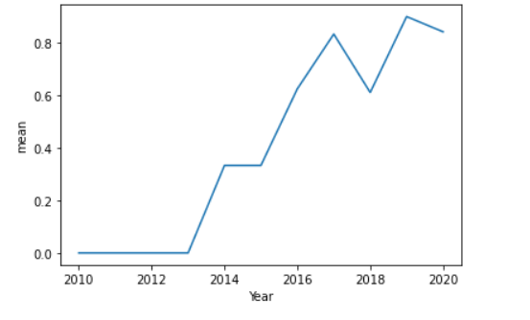
Launch Success Yearly Trend
The plot shows the mean success rate for each year.
From 2013 there is increase in the mean success rate.
There is a drop in 2018 which will require more investigation as to why this occurred.

Slide 24
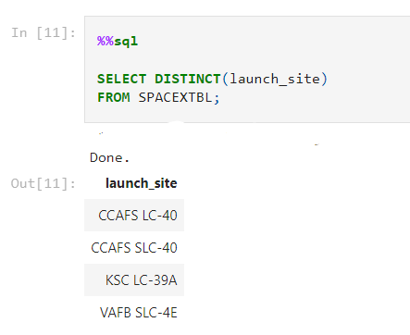
All Launch Site Names
By using DISTINCT we are able to show all the specific sites where the rockets were launched from

Slide 25
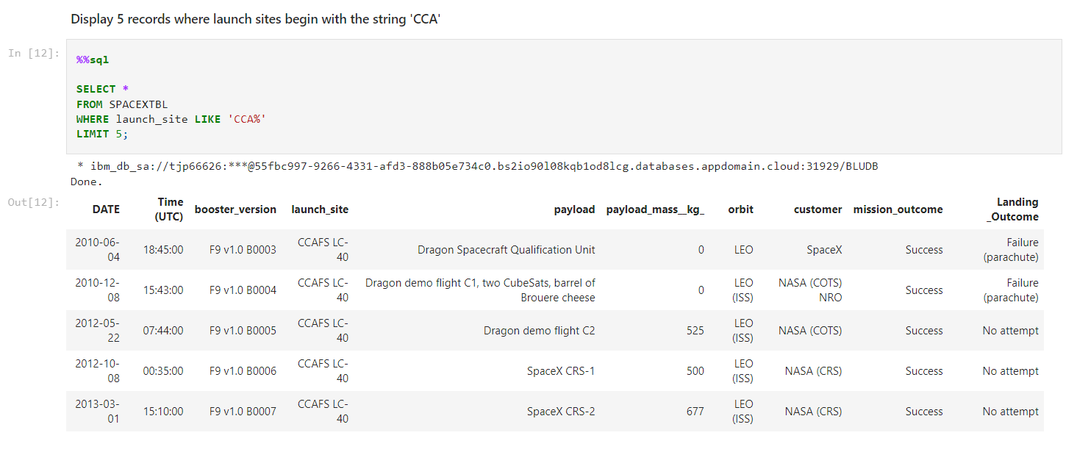
Launch Site Names Begin with 'CCA'
This was achieved the use of LIKE alongside the WHERE clause

Slide 26
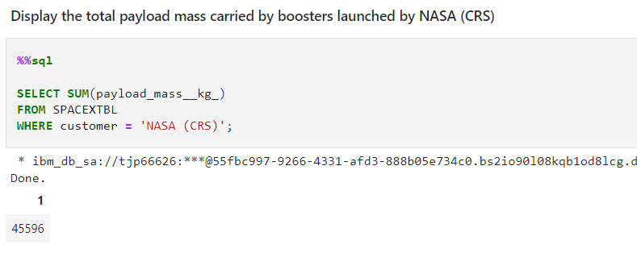
Total Payload Mass
Used the SUM function to add all the payload masses and with the WHERE clause specify the customer in question which is NASA (CRS)

Slide 27
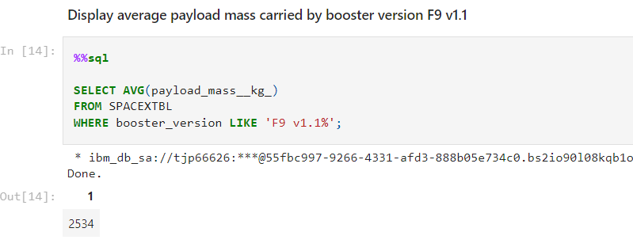
Average Payload Mass by F9 v1.1
Used the AVE (average) function to calculate the average of the booster version which was specified with the use of the WHERE clause.

Slide 28
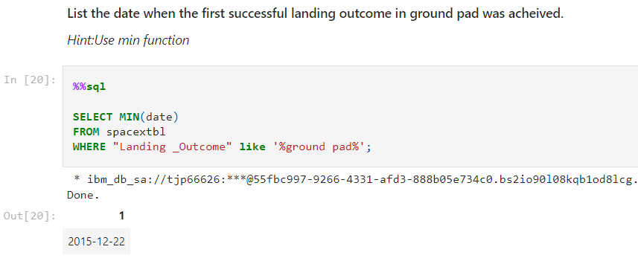
First Successful Ground Landing Date
By using the minimum function, we are able to obtain the first date when the 1st successful ground landing occurred. The WHERE and LIKE clauses helped to be more specific of the type of landing outcome required which is “ground pad”

Slide 29
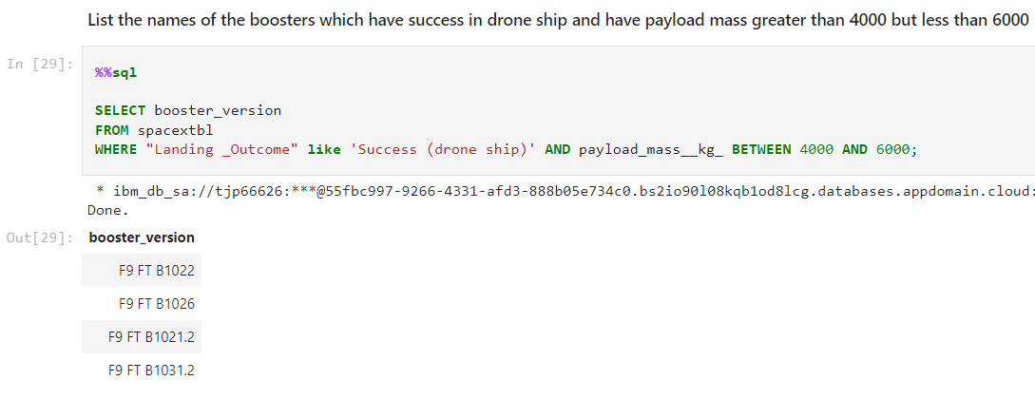
Successful Drone Ship Landing with Payload between 4000 and 6000
The query enlists the use of AND clause to obtain the booster names that were successful on drone ships and with the use of BETWEEN clause specify the payload mass
Present your query result with a short explanation here

Slide 30
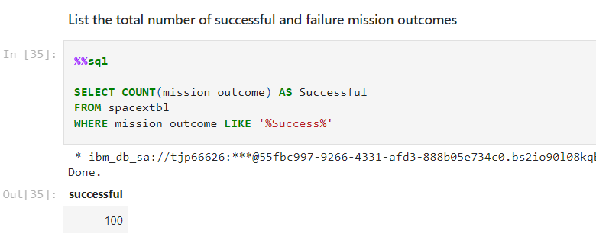
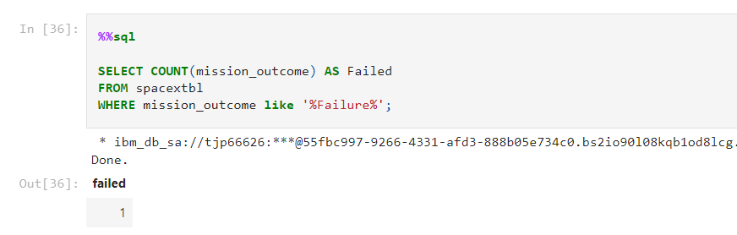
Total Number of Successful and Failure Mission Outcomes
To obtain the count of all the successful mission outcomes, the LIKE clause was used should there be more words before or after the word “Success”
The same method was applied to find the number of failed mission outcome

Slide 31
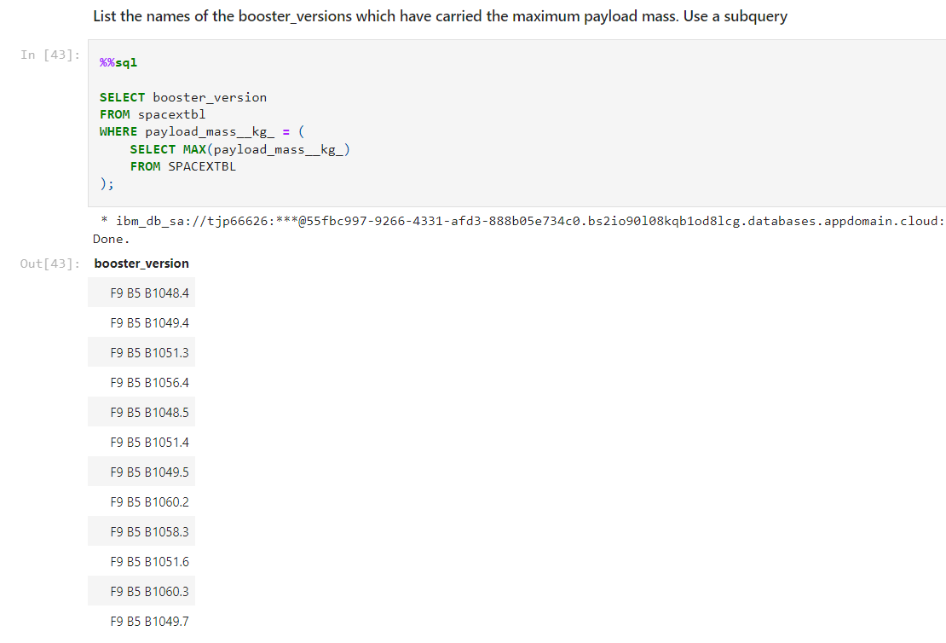
Boosters Carried Maximum Payload
This query required the use of a sub-query which will first obtain the maximum payload mass
Then the booster versions with the maximum payload mass could then be obtained

Slide 32
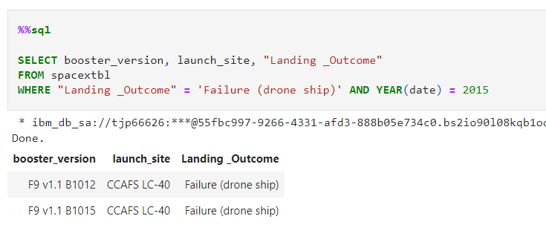
2015 Launch Records
To get the records for the year 2015 as we have a date column, the YEAR function was used to extract the year from the date and check it is 2015 in addition to using the WHERE clause to indicate the landing outcome

Slide 33
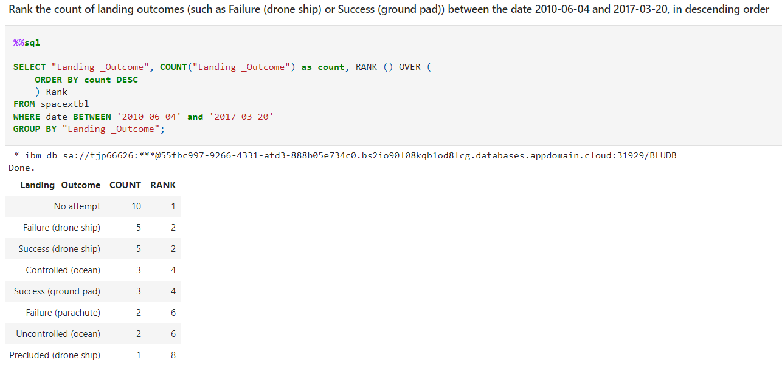
Rank Landing Outcomes Between 2010-06-04 and 2017-03-20
This query required the use of COUNT, WHERE, BETWEEN and RANK in order to show the number of each landing outcome between a set of dates as rank them based on the number.

Slide 34

Section 3

Slide 35
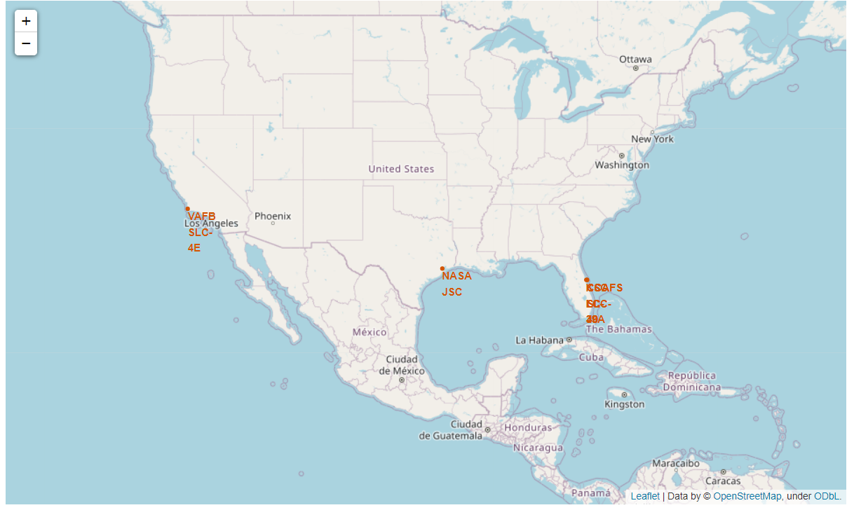
Launch Sites Location
With folium we are able to show the distinct locations from where the rockets were launched from. And it lies in the USA coastal areas

Slide 36
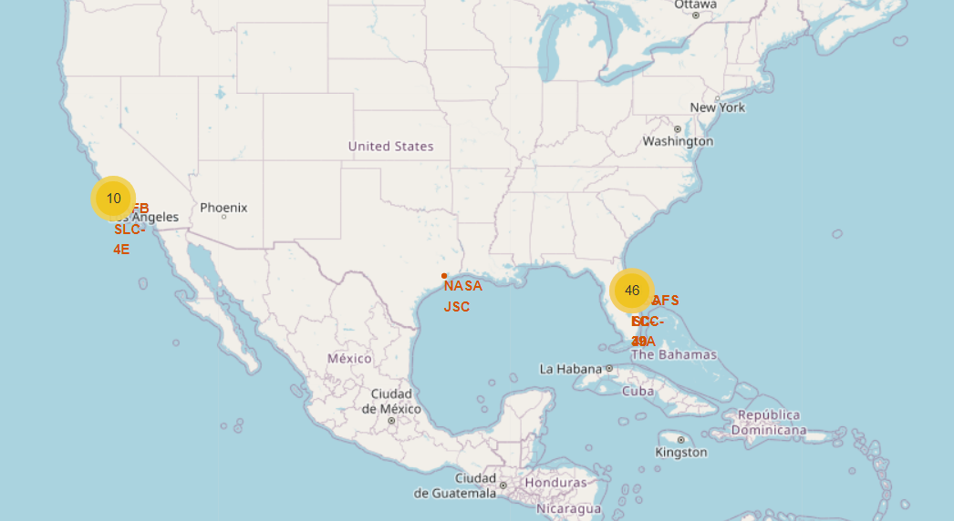
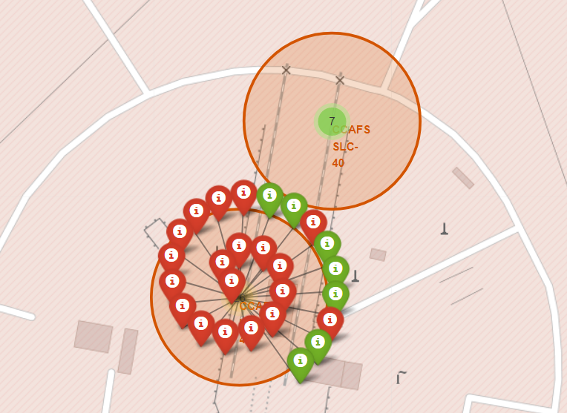
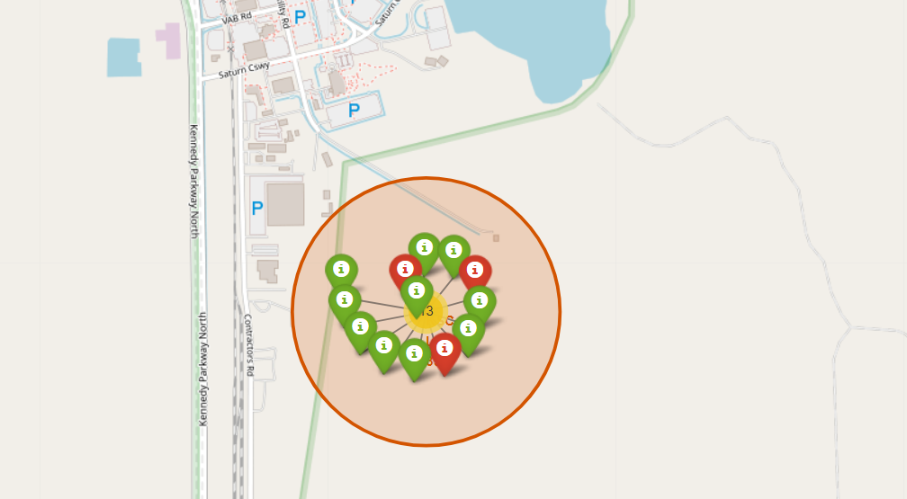
Successful and Failed Launches
From the folium maps, we are able to see the number of launches at each site.
Zooming in on each site, we can then see the number of failed and successful launches denoted by red and green markers respectively

Slide 37
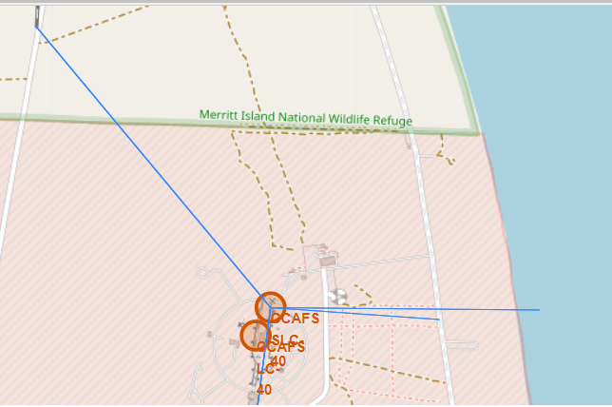
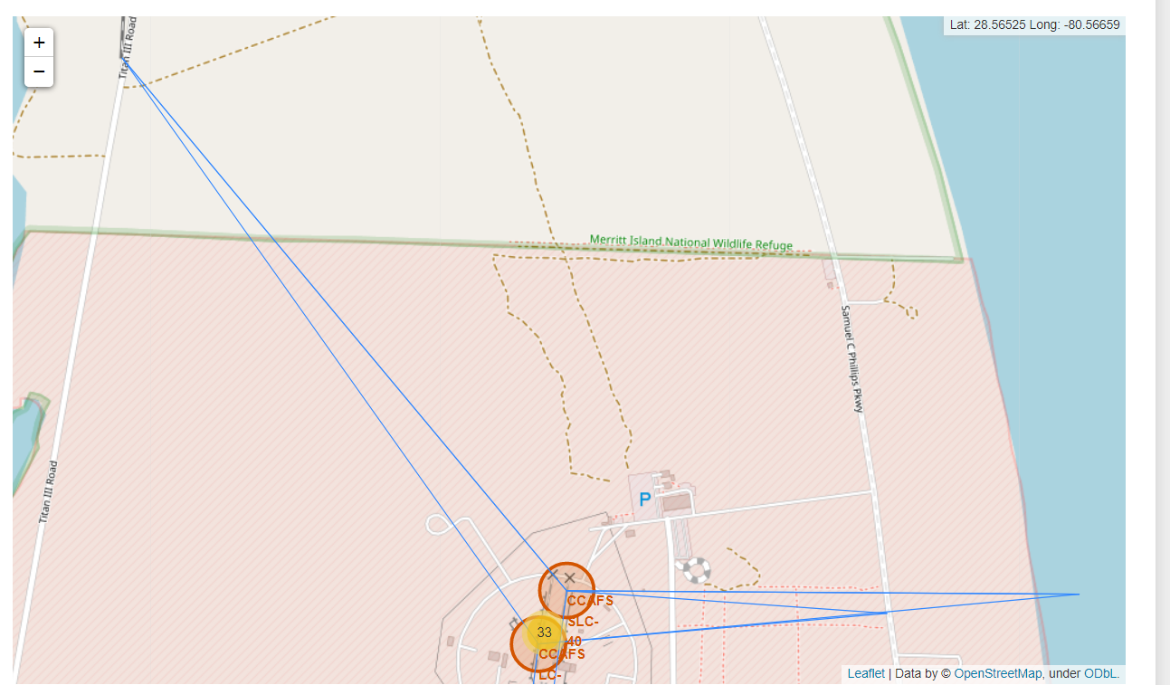
Proximity Distance
By plotting the lines from the launch sites to certain locations we are able to see what they are in close proximity to which include highways and coastlines and what they are not in proximity to which include cities and railroads

Slide 38

Section 4

Slide 39

Launch Sites Success Percentage
Here we are able to see the percentage of success for all the launch sites using a pie chart
From this we can quickly see that Launches from KSC LC 39A have a high chance of been successful while the site with the least chance of success is CCAFS SLC-40

Slide 40

Launch site with Highest success rate
We can see that the success rate for KSC LC-39A is 76.9% with a 23.1% chance of a launch failing

Slide 41
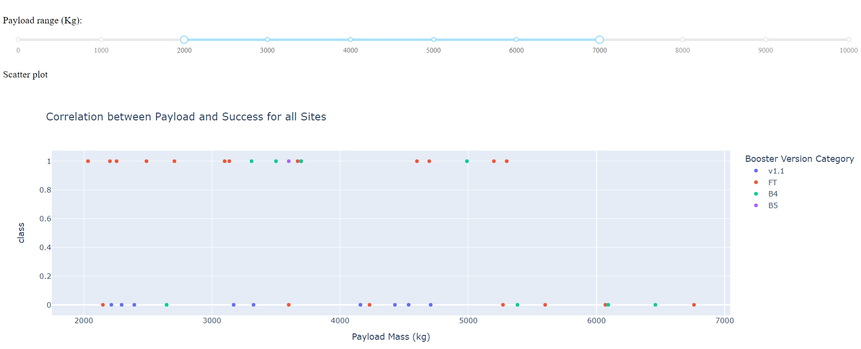
Payload Mass vs Landing Outcome Class
The scatter plot shows the payload mass between 2000kg and 7000kg and their outcomes whether successful or not

Slide 42

Section 5

Slide 43
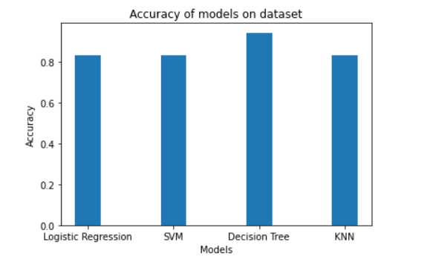
Classification Accuracy
The accuracy of each model was brought together and plotted in a bar chart.
From the bar chart you can see that the most accurate model is the Decision Tree which is 0.94

Slide 44
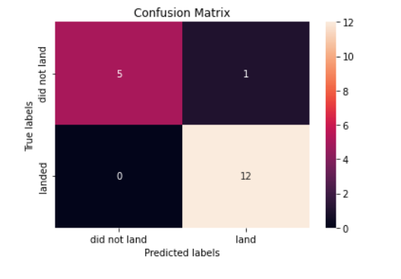
Confusion Matrix
This Confusion matrix is for the Decision Tree model.
This matrix shows performance of our model which is the most accurate.
We can that for all the launches that landed successfully the model was able to predict them all.
While for the launches that did not land successfully, the model was able to correctly predict 5 out of 6 which is quite good (1 false positive).

Slide 45
Conclusions
Point 1
Point 2
Point 3
Point 4
…

Slide 46
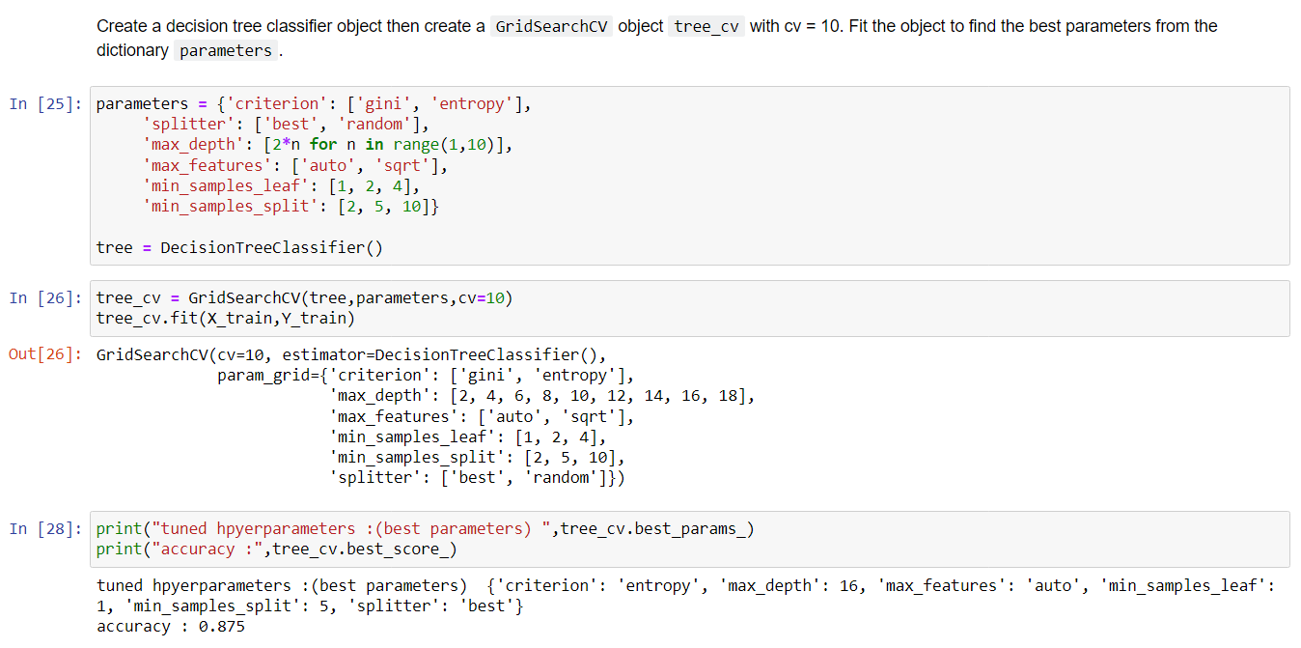
Appendix
GitHub repository: https://github.com/Ebuka21/IBM_Data_Science

Slide 47


